Slide 1
Programming Project
Team 34
Mohamed Hesham 2023 / 00428
Ahmed Mostafa 2023 / 03479
Ali Ahmed 2023 / 06015
Mohamed Hany 2023 / 01319

Slide 2
Table of contents
01
02
03
04
05
06
The
Interface
Function
prototypes
File I/O
Display Patients
07
08
Adding Patients
Search for a patient
Updating Patients / Calculating Bill
Discharge Patients

Slide 3
01
Hospital Managment
The Interface

Slide 4
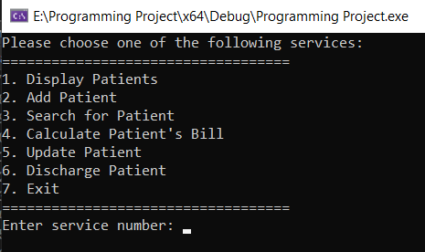
The Interface

Slide 5
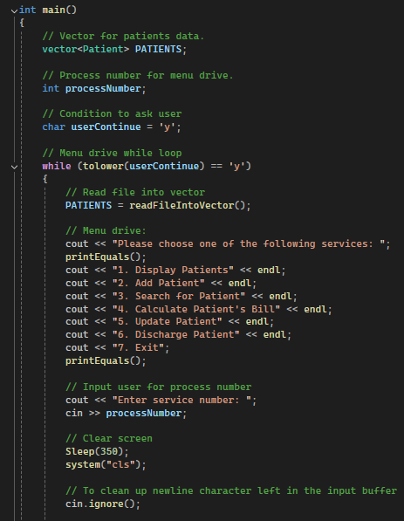
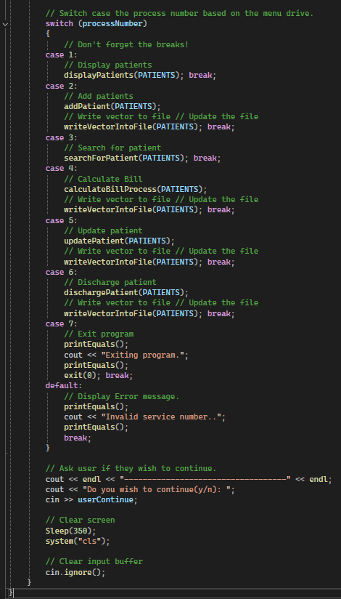
The Interface

Slide 6
02
Hospital Managment
Function Prototypes

Slide 7
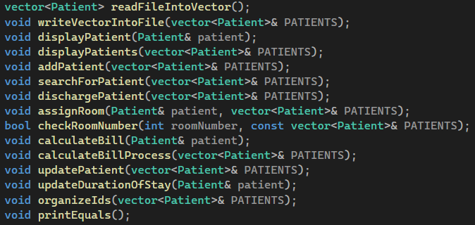
Function Prototypes

Slide 8
03
Hospital Managment
File I/O

Slide 9
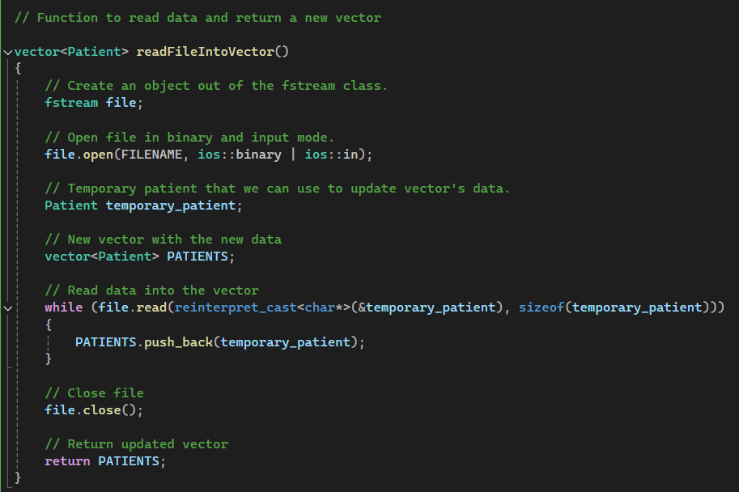
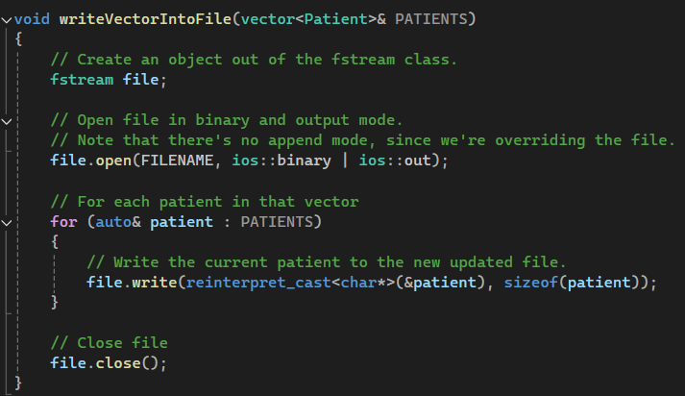
Reads The data and returns a new vector
Writes the updated vector

Slide 10
04
Hospital Managment
Display Patients

Slide 11
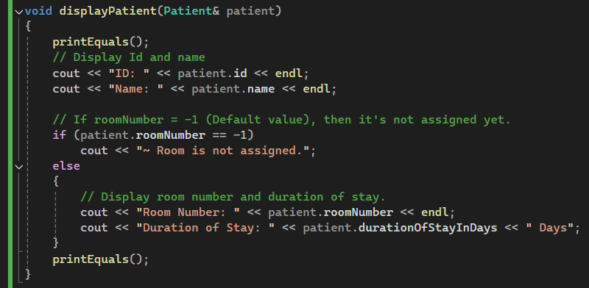
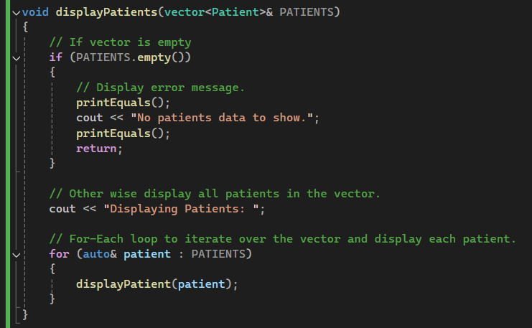
Displays only a single patient
Displays the patients inside of a vector.

Slide 12
05
Hospital Managment
Adding Patients

Slide 13
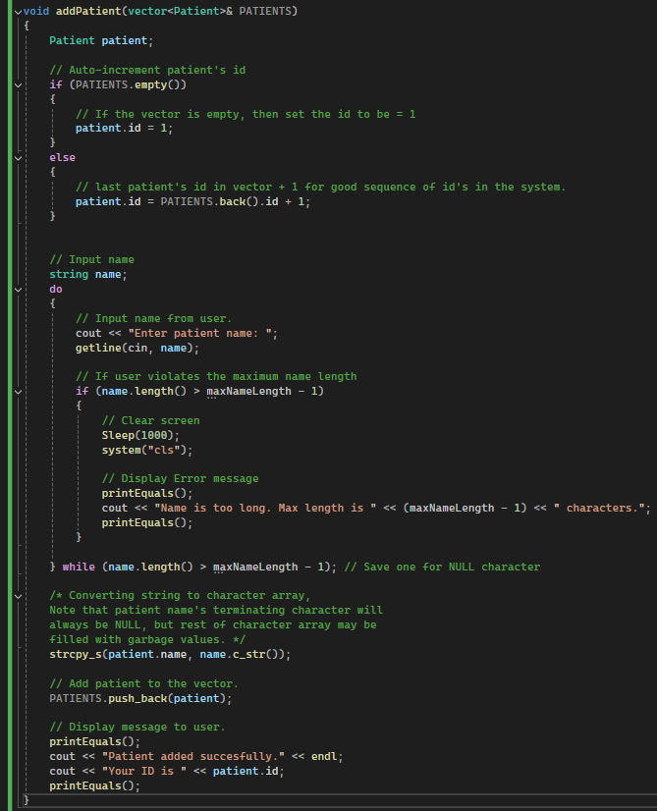
Adds a patient to a vector.

Slide 14
06
Hospital Managment
Search for patient

Slide 15

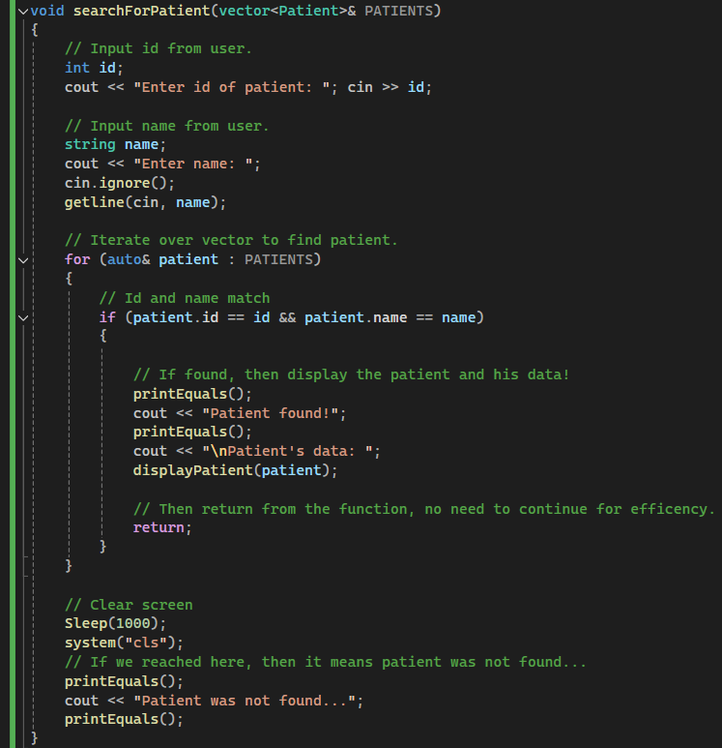
Searches for a patient in a vector

Slide 16
07
Hospital Managment
Updating Patients / Calculating Bill

Slide 17
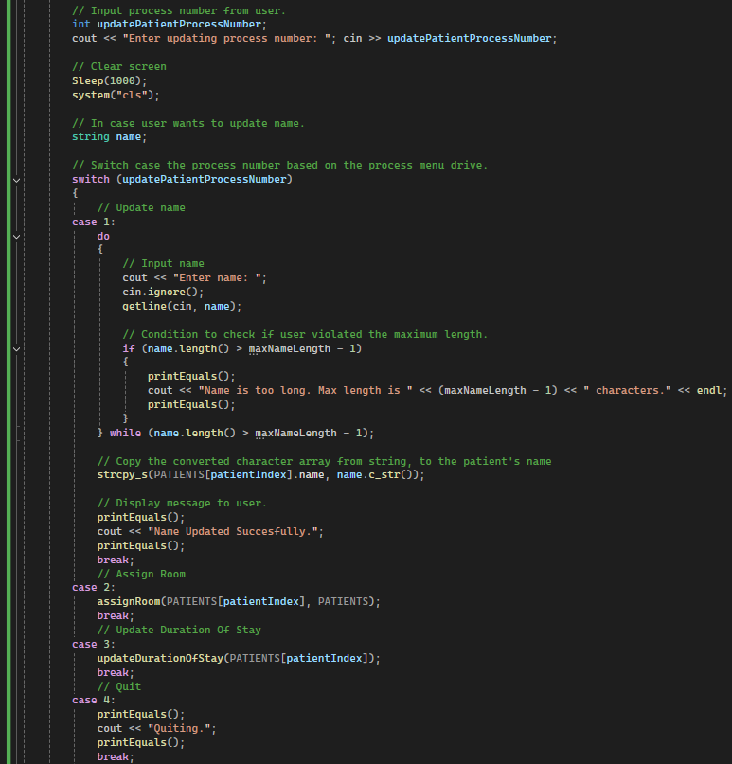
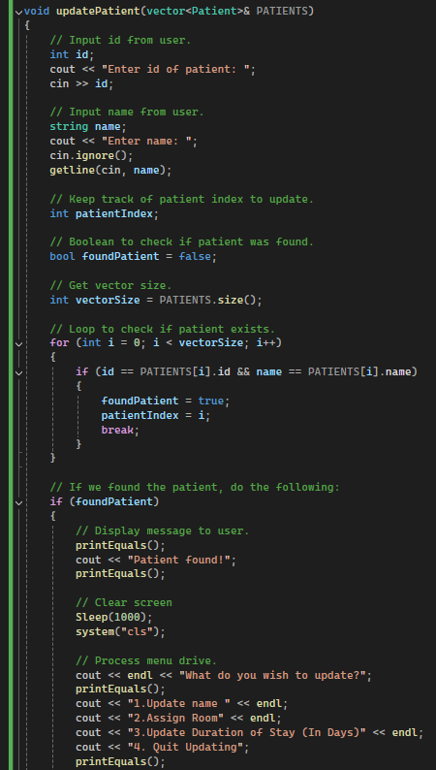
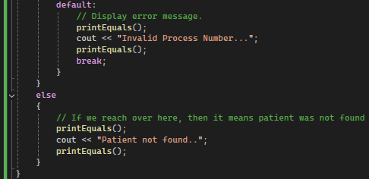
updates a patient’s information

Slide 18
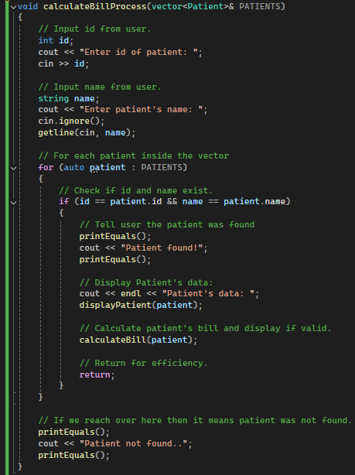
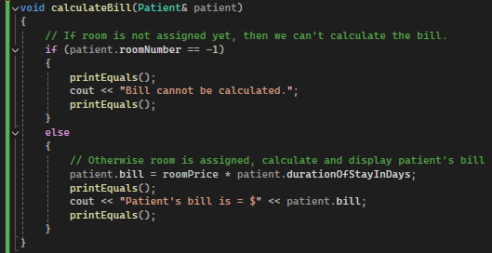
Calculates Patient’s Bill

Slide 19
08
Hospital Managment
Discharge Patients

Slide 20
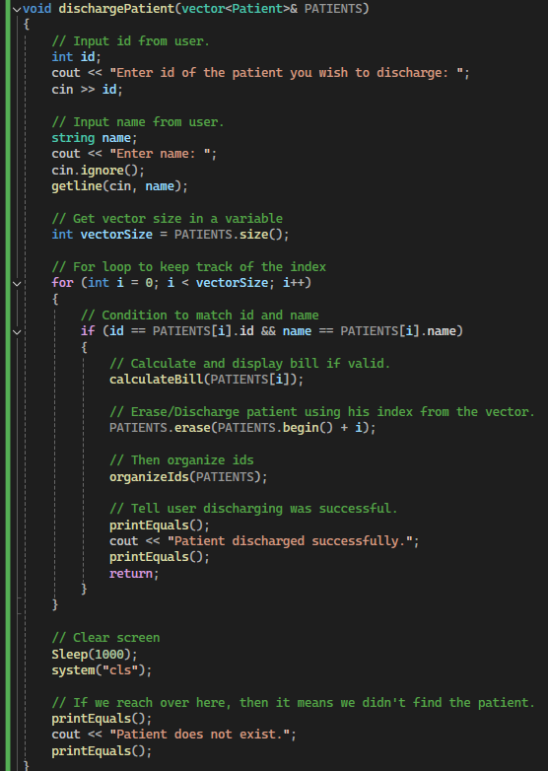
discharges a patient (Completely remove from the system)

Slide 21
Hospital Managment
Extra Functions

Slide 22
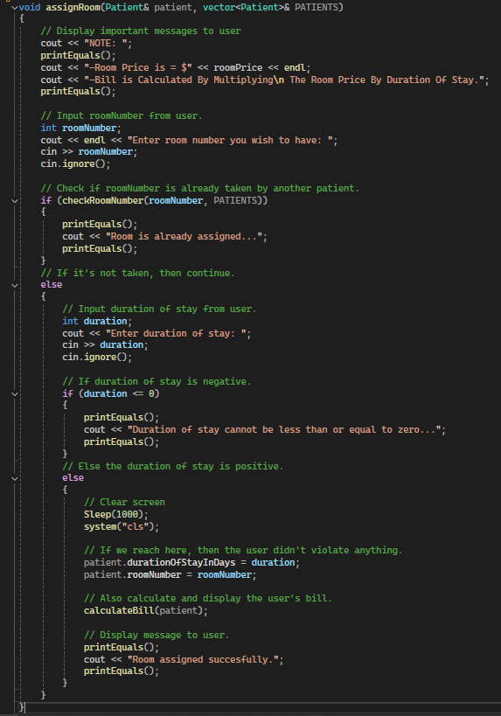
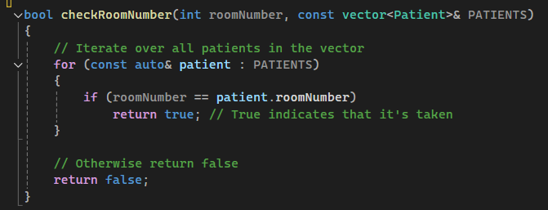
checks if a room number is already assigned
Assigns a room to a patient

Slide 23
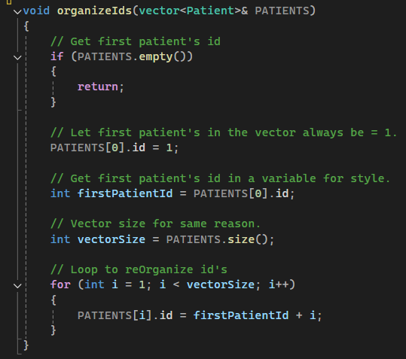
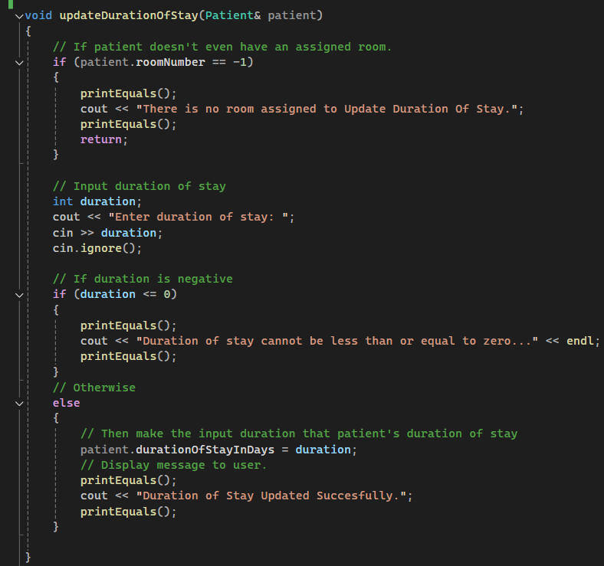
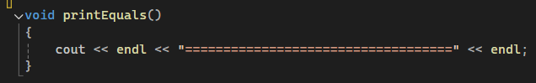
Updates a patient's duration of stay
Organizes patient's id after discharging a patient
Prints borders on the screen

Slide 24
Thanks!
Any questions?

